Slide 1
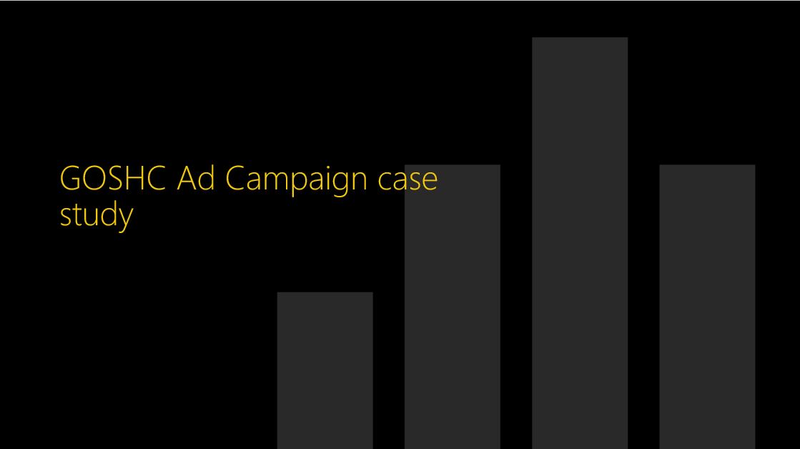

Slide 2
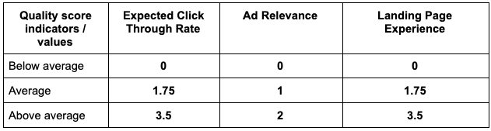
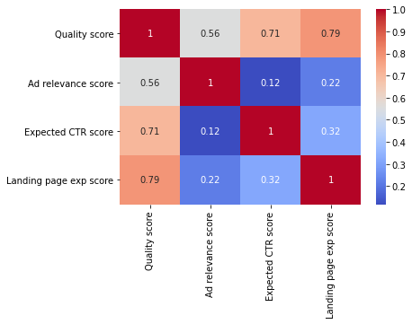
Quality Score Formula
Q1. What factor(s) has the strongest
impact on Quality Score?
Correlation Matrix Of Quality Score and its Factors
‘Landing Page Experience’ has the highest correlation (0.79) with Quality Score, followed by ‘Expected CTR Score’.
This is a strong positive relationship with the Quality Score, means Search Keywords with better LPE has better Quality Score . This is further evidenced on the ‘Distribution’ report in the Power BI file.
The Landing Pages of Search Keywords should be of highest quality.

Slide 3
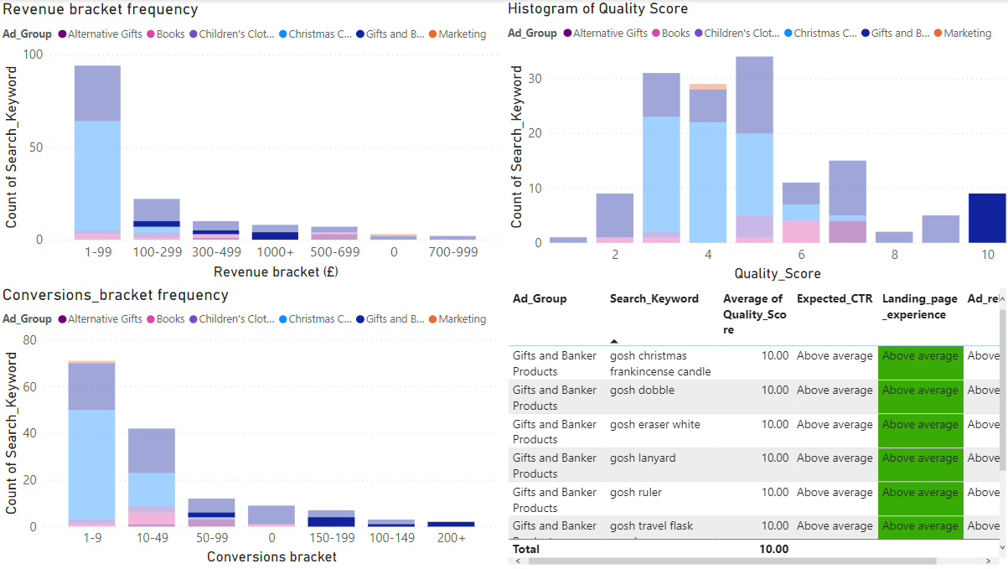
Distributions
Distributions
Notes:
Histogram of Quality Score
No alt text provided
Revenue bracket frequency
No alt text provided
Conversions_bracket frequency
No alt text provided
tableEx
No alt text provided

Slide 4
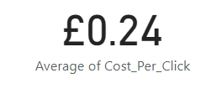
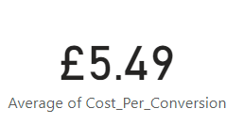
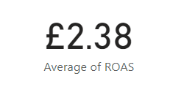
Average Cost Per Click
Q2. Payment Per Click (PPC) Optimization
Total Cost / Number of Clicks
Average Cost Per Conversion
Currently, The charity is spending average of £5.49 for a single conversion and getting an average of £2.38 for every £1 spent on clicks.
While this is not a loss, the organization should try to reduce the ‘Cost Per Conversion’ by getting more conversions from clicks.
Total Cost /
Number of Conversions
Average Return on Ad Spend
Total Revenue /
Total Cost

Slide 5
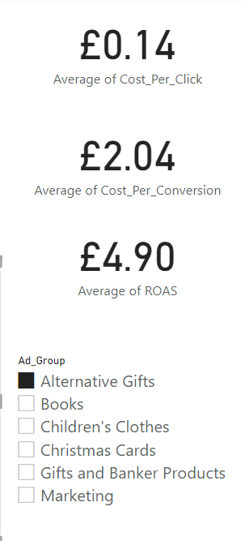
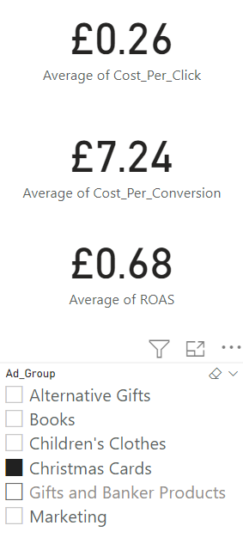
Q2. Payment Per Click (PPC) Optimization
To maximize performance of the portfolio;
i. Increase Total Revenue or
ii. Reduce Total Cost
The organization should try to reduce the ‘Cost Per Conversion’ by getting more conversions from clicks.
The lower the ‘Cost Per Conversion’, the more the value
derived from ‘Cost of Clicks’ and the higher the ‘Return
on Average Spend’ ROAS.
ii. Another way to get more Return on Ad Spend is to
remove redundant Search Keywords. Redundant
keywords drives ‘Total Cost’ up, reducing ‘rk’
will result in increased ROAS.

Slide 6
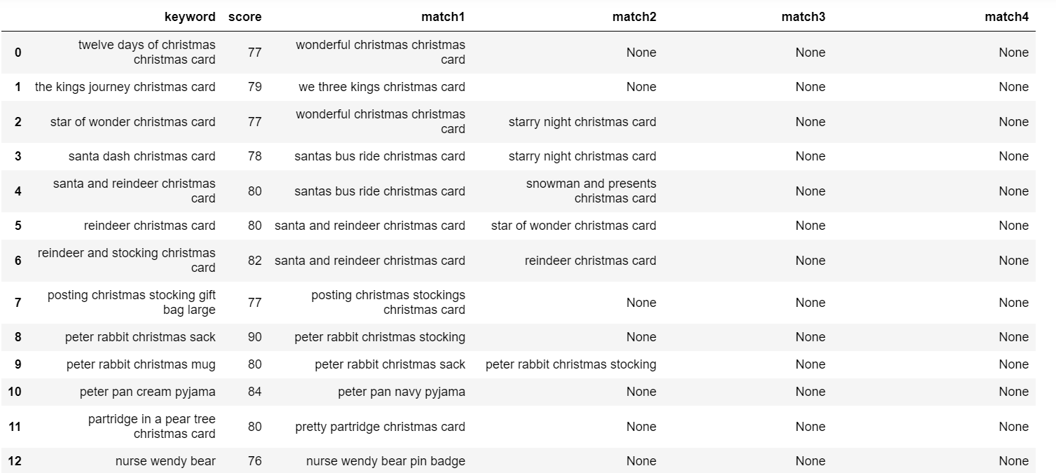
Example of Redundant keywords

Slide 7
Q2. Payment Per Click (PPC) Optimization
c. Implementing strategy in business and measure
impact
- A Two Sample Test of Mean can be conducted to see if there’s a significant difference in the average Conversions and average ROAS
of Ad groups after making necessary keywords improvements / improving the landing page experience.
i. Null Hypothesis: There’s no difference between the Conversions
before and after improving Landing Page
Experience/ improving keywords
ii. Null Hypothesis: There’s no difference between ‘Return on Ad
Spend’ before and after improving Landing
Page Experience/ improving keywords
The Search Keywords to be used could be duplicated with
different landing pages to see the landing page with more
conversions and ROAS for each keyword

Slide 8
